Slide 1
California Canary Rockfish Data Considerations for the 2023 Assessment
presented by:
Dr. John Budrick and Melissa Mandrup, California Department of Fish and Wildlife

Slide 2
Distribution and Life History
Range is primarily north of Point Conception with a few caught south of Point Conception past the edge of their primary distribution.
Prefers edges of reef and sand waves as juveniles, then sub-adults make an ontogenetic movement to deeper depths from waters as shallow as 11 m.
Shelf species with adults most abundant between 80 and 200 m depth, with young fish shallower than adults coastwide.
Genetically homogenous across their range in the West Coast due to high movement of adults observed in tagging studies and potentially during pre-settlement larval dispersal.
Schooling semi-pelagic species spends considerable time toward the bottom but suspend making them vulnerable to trawl gear.

Slide 3
Recreational Regulation History
Declared overfished in 2000
One fish bag limit, season and depth restrictions implemented in 2001.
Prohibited retention south of Cape Mendocino in 2003
Prohibited statewide in 2004
Dictated RCA depth restrictions and season length north of Point Conception through rebuilding, constraining access the primary depth distribution of adults. Few and smaller fish observed as a result from 2001 to 2018.
Access also continued to be constrained by avoidance of yelloweye rockfish. Though partial all depth seasons allow access part of the year since 2019 in the Mendocino and Northern Management Areas.
Precautionary “slow up” approach to allowed retention.

Slide 4
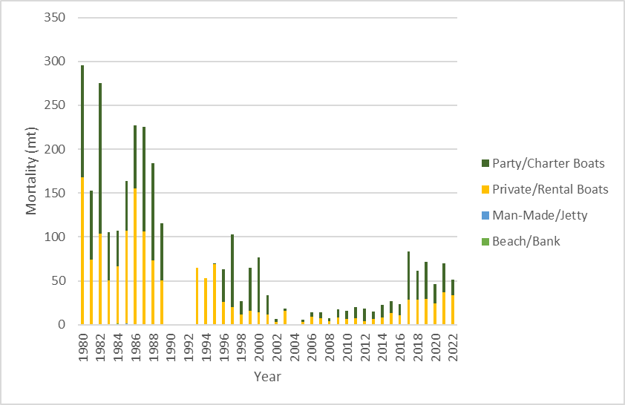
Recreational Catch by Mode 1980-2022
2001 One Fish Bag Statewide, Depth Restrictions, Season Limits
2003 Prohibited South of Cape Mendocino
2004 Prohibited State Wide
2017 Resumed Retention
Declared Overfished
2015 Rebuilt

Slide 5
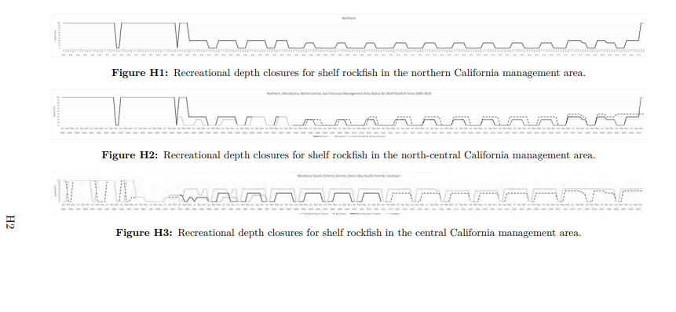
Season/Depth Restrictions for Northern California
Credit: Melissa Monk from Vermilion/Sunset Assessment
Notes:
Produced by Melissa Monk, can she update.

Slide 6
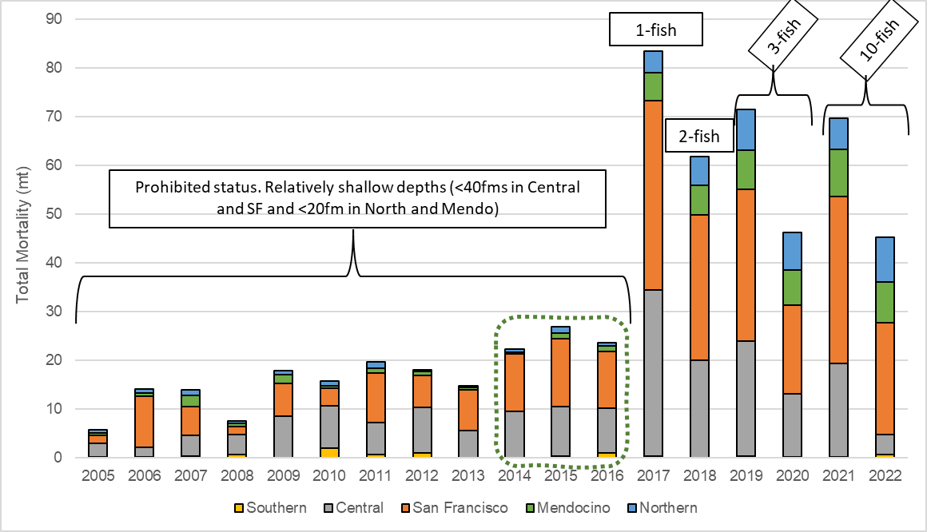
Recreational Catch History 2005-2022
Notes:
Total mortality estimates (mt) of canary rockfish for all fleets by Management Area from 2005-Oct 2022; not shown are discarded alive fish - see next two slides for total encounter information including discarded alive fish. From 2005-2016 canary rockfish was a prohibited species and most caught fish were discarded. Also, between 2005-2016 the seasons were shorter, with shallower depths that did not provide access to the main bulk of the canary rockfish stock, especially in the areas canary rockfish are more commonly found. From 2014-2016 (green dotted outline) encounters of canary rockfish increased and anecdotal reports from PC operators in the San Francisco Management Area indicated difficulty in avoiding the species when targeting other rockfish. Beginning in 2017 the bag limit was increased to 1-fish within the 10-fish daily RCG bag limit, following the stock being declared rebuilt. Seasons and depths began expanding in more meaningful ways that year, with the Northern Management Area allowing fishing out to 30 fm for the first time in over a decade. The bag limit was increased to 2-fish in 2018, and 3-fish in 2019, although catches still remained under the California recreational HG. In 2021 the sub-bag limit for canary rockfish was eliminated. The depth limit in the San Francisco and Central Management Areas were both set to 50 fm, and in the Northern and Mendocino Management Areas the depth limit was 30fm from May-Oct and no depth limit for Nov-Dec.

Slide 7
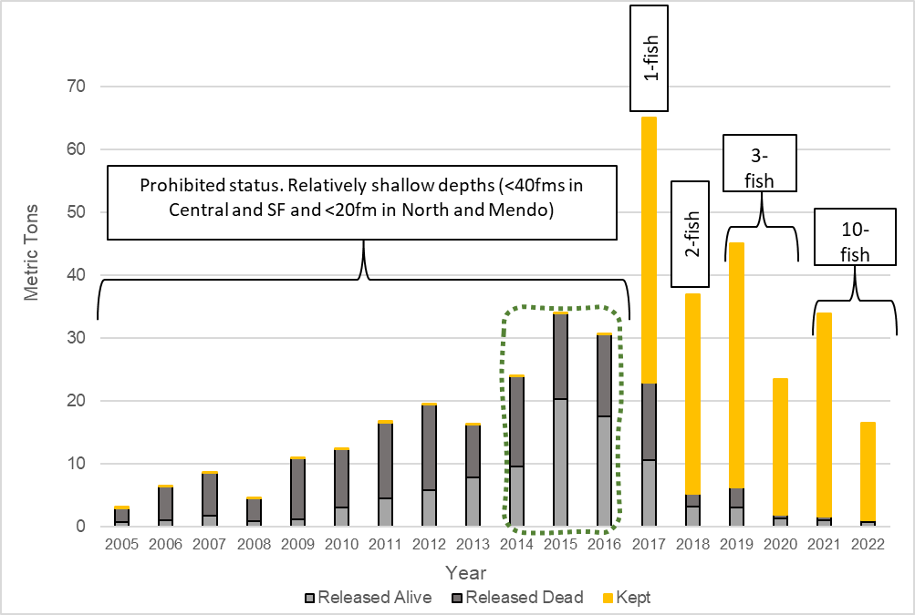
PC Fleet Total Encounters
Notes:
Recreational canary rockfish estimates of total encounters (mt) by kept (dead), discarded dead, and discarded alive by year for the PC mode from 2005-Oct 2022. From 2005-2016 canary rockfish was a prohibited species and most caught fish were discarded. Also, between 2005-2016 the seasons were shorter, with shallower depths that did not provide access to the main bulk of the canary rockfish stock, especially in the areas canary rockfish are more commonly found. From 2014-2016 (green dotted outline) encounters of canary rockfish increased and anecdotal reports from PC operators in the San Francisco Management Area indicated difficulty in avoiding the species when targeting other rockfish. Beginning in 2017 the bag limit was increased to 1-fish within the 10-fish daily RCG bag limit, following the stock being declared rebuilt. Seasons and depths began expanding in more meaningful ways that year, with the Northern Management Area allowing fishing out to 30 fm for the first time in over a decade. The bag limit was increased to 2-fish in 2018, and 3-fish in 2019, although catches still remained under the California recreational HG. In 2021 the sub-bag limit for canary rockfish was eliminated. The depth limit in the San Francisco and Central Management Areas were both set to 50 fm, and in the Northern and Mendocino Management Areas the depth limit was 30fm from May-Oct and no depth limit for Nov-Dec.

Slide 8
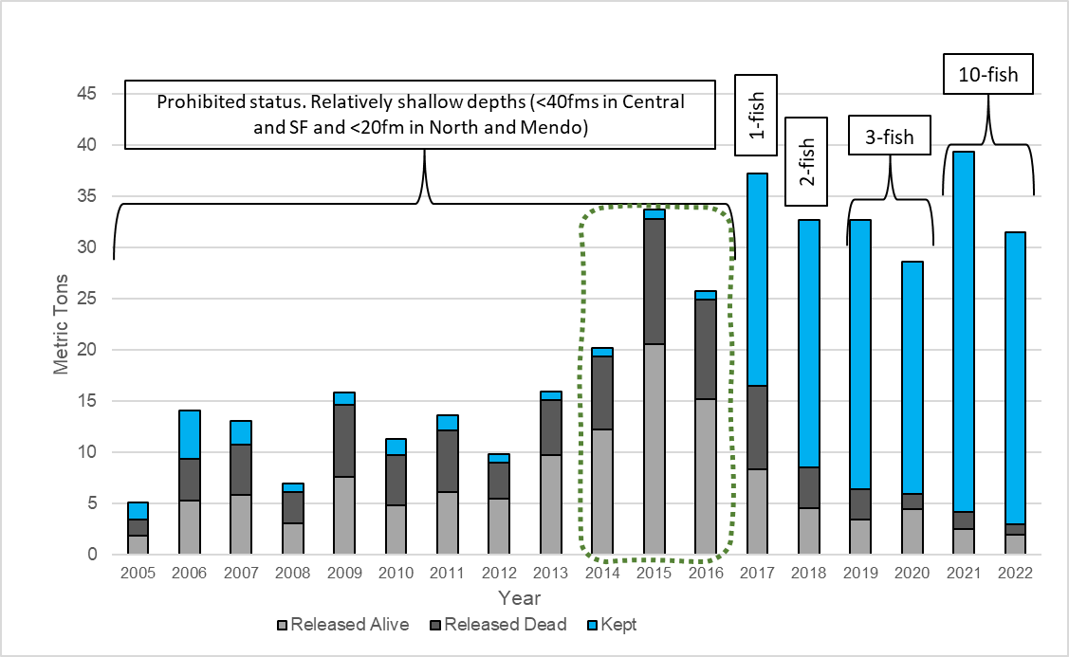
PR Fleet Total Encounters
Notes:
Recreational canary rockfish estimates of total encounters (mt) by kept (dead), discarded dead, and discarded alive by year for the PR mode from 2005-Oct 2022. Similar to the slide for the PC fleet, prior to 2017 canary rockfish were primarily discarded when caught due to the prohibited status. Significant reductions to discards are seen beginning in 2017 with the 1-fish bag limit allowance, and continued decreases to discards through 2022 with the increases to bag limits.
Other regulatory and environmental considerations discussed from fleetwide and PC slides apply here. One noticeable difference between the PC and PR trends seen in 2020 through present is a relatively stable or slightly increasing trend of canary encounters in the PR fleet. This could be due to the PR fleet not needing to follow the same social distancing requirements as the PC fleet due to COVID

Slide 9
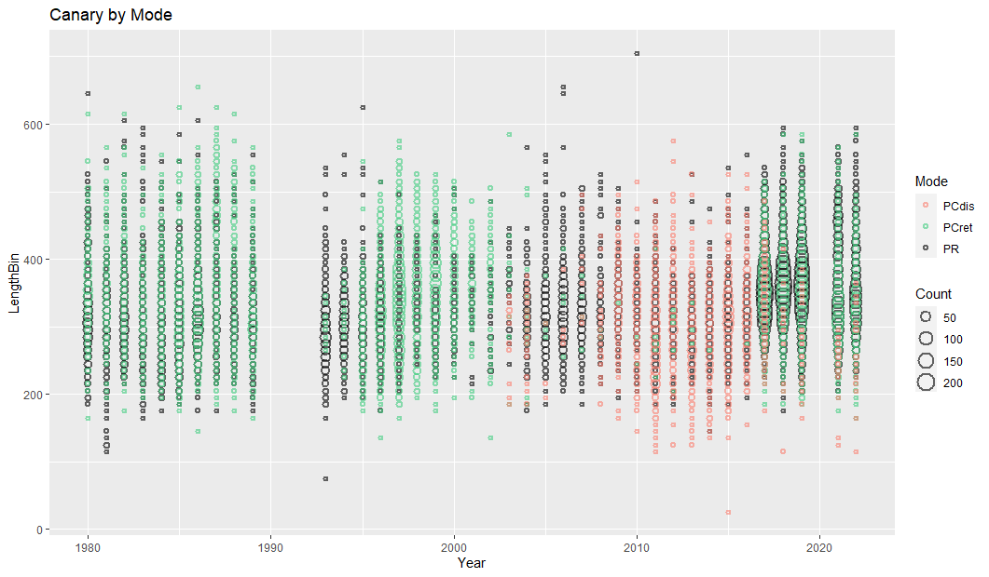
Length Composition Over Time
2001 Season and Depth Restrictions+ Bag Limits
2017 Retention resumes 1 fish bag limit, Depth liberalized
2018 2 fish bag
2019 - 2020 3 fish bag
2000 Declared Overfished
2015 Rebuilt
Ten fish bag

Slide 10
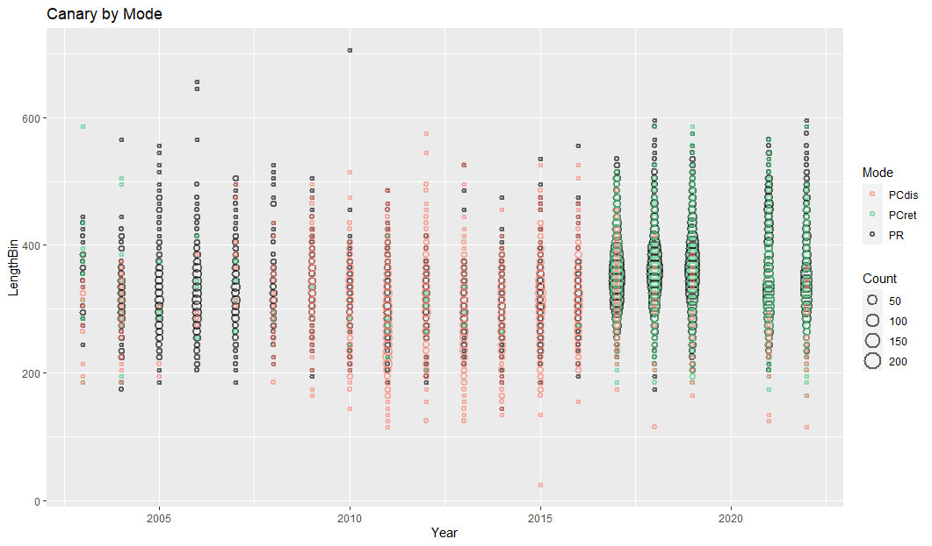
PC Retained vs. PC Discard 2003-2016
2003 Discard Lengths Collected Onboard CPFV
2017 Retention Resumed

Slide 11
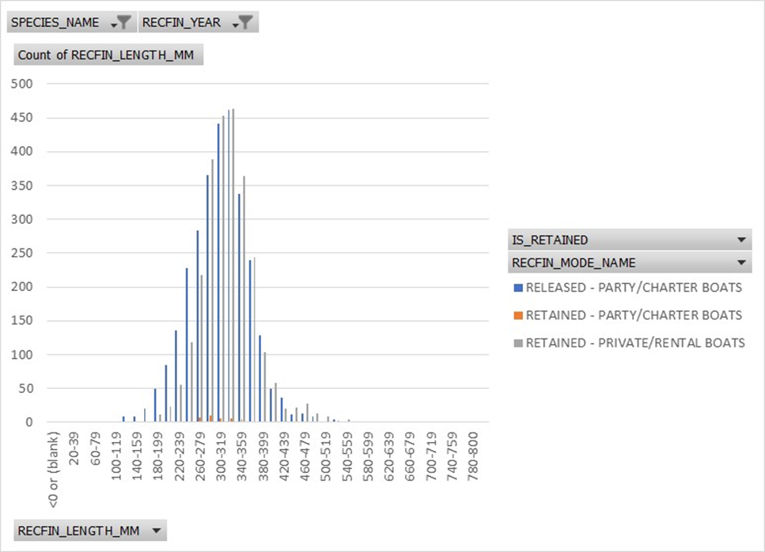
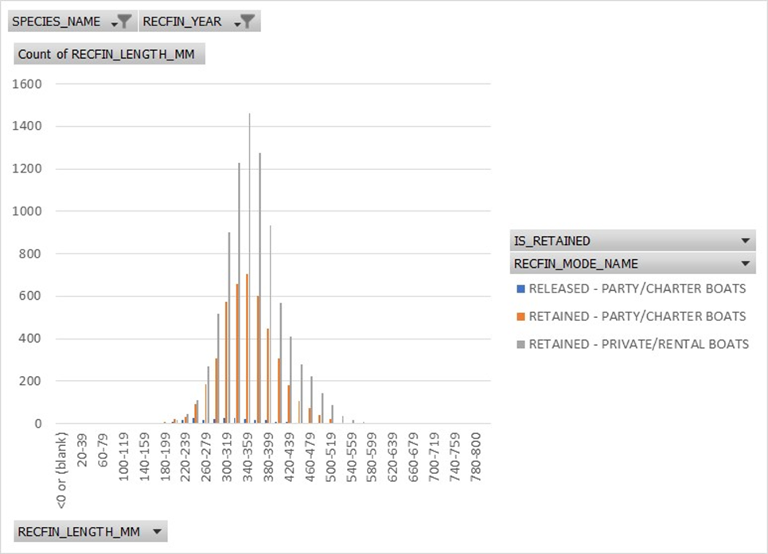
Use of Discard Composition Data during Prohibition on Retention?
2003-2016
2017-2022

Slide 12
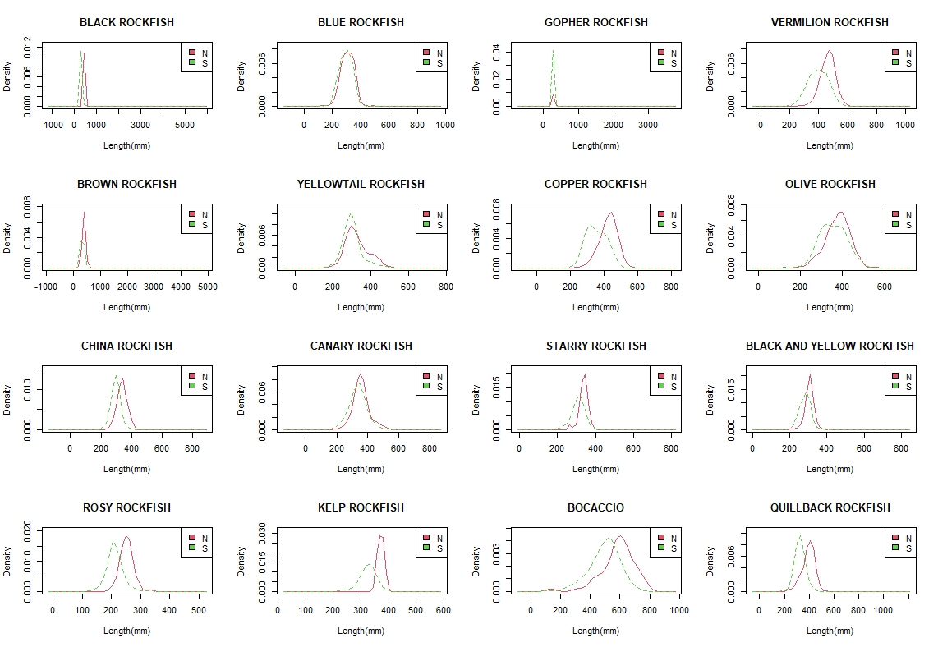
Recreational Composition North of Point Conception stratified at Point Arena
Notes:
Length comps for the top 16 rockfish species north of Pt Conception. Samples collected were collected from all modes between 2005-2019. Only samples north of Pt Conception are included and are shown divided north and south of Point Arena. Looking at canary, there is not much difference between fish observed north or south of Point Arena, so not a big concern about data weighting etc. to reflect the longer season south vs. north as for quillback or copper.

Slide 13
Data Gaps
1980 MRFSS estimate not used last assessment, averaged 1979 and 1981.
1990-1992 gap in sampling. Downward trend in catch over longer term. Ramp considered.
1993 and 1994 Party Charter estimates are blank.
1995 Party Charter estimates are suspiciously low.
2004 Estimates are currently blank on RecFIN. Historical estimates can be provided or re-estimation efforts in progress.
Proxy estimates for 2020 from April to June due to COVID.
Could use 2019 as a proxy, bag limit changes over time, depth and season differences in prior years. Values from the GMT?
The 2020 COVID effect on RFGEN makes the 2020 CPUE questionable for the recreational fleet.
Check to see if RFGEN effect lingered into later years.
Bag limit effects on CPUE are a consideration.
Onboard CPFV index may be more robust if retained and discarded are included from 2003 onward.

Slide 14
Commercial Regulation History
Prohibition of Roller Gear in the Trawl Fishery in 1995. Small footrope limited access to rocky reef habitat.
Prohibition on retention began in the early 2000s for commercial fisheries.
RCAs prohibited access to the primary adult depth distribution.
Minor adjustments to non-trawl RCA in 2017, allowed some access to shelf.
Trawl RCAs removed in 2020 south of 46 N lat.
Retention resumed in 2017 in all fisheries
Non-trawl EFPs had low set asides, access to RCA.
Mid water trawl EFP activity in CA begin in 2018, used quota, access to RCA

Slide 15
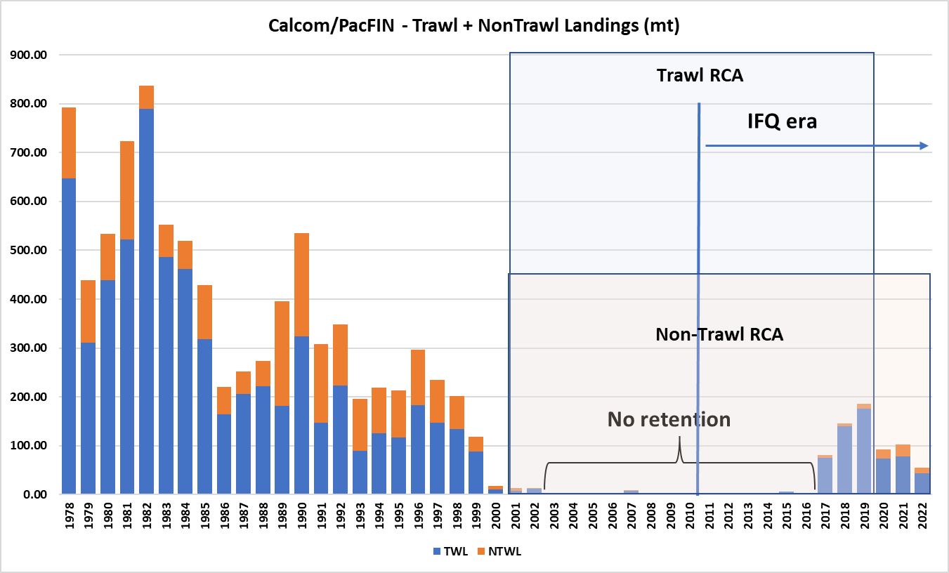
Commercial Catch History

Slide 16
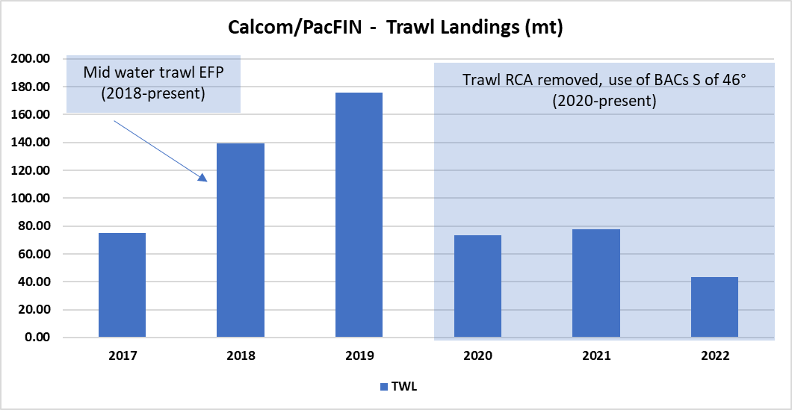
Recent Management Changes in the Trawl Fishery

Slide 17
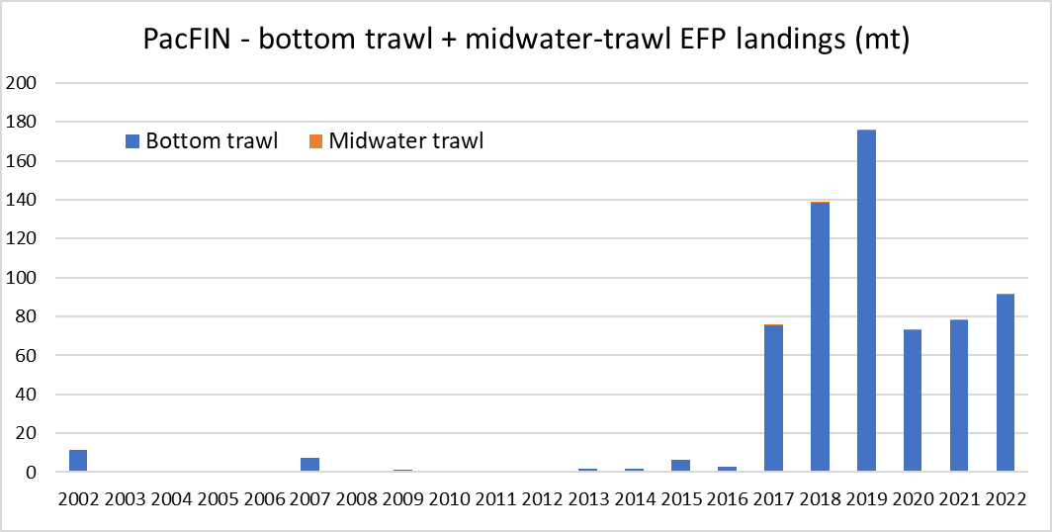
PacFIN - Trawl Landings (mt), EFP vs Directed fishery

Slide 18
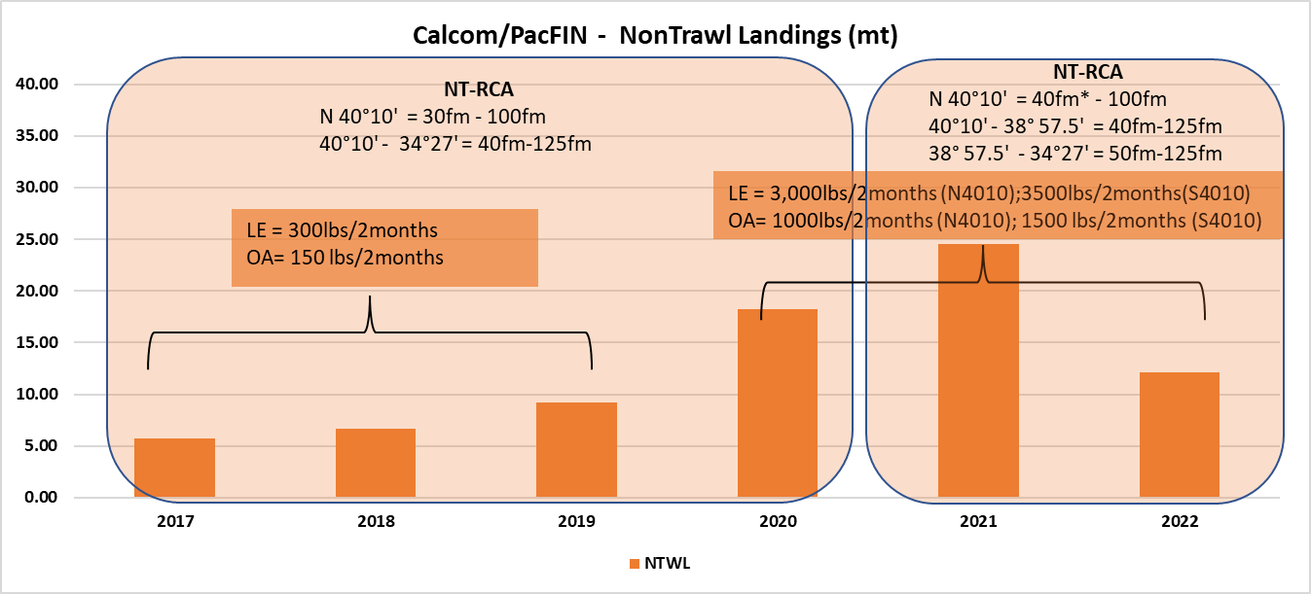
Recent Management Changes in the Non-trawl Fishery

Slide 19
PacFIN - Non Trawl Landings (mt), EFP vs Directed Fishery
Non-trawl EFPs | 2017 | 2018 | 2019 | 2020 | 2021 | 2022
Real Good Fish |  |  |  | 0.01 | 0.01
SFCF | 0.02 | 0.11 | 0.05 | 1.28 | 0.38 | 0.08
Grand Total | 0.02 | 0.11 | 0.05 | 1.29 | 0.40 | 0.08
Sector | 2017 | 2018 | 2019 | 2020 | 2021 | 2022
Non Nearshore | 2.8 | 3.0 | 2.7 | 7.7 | 11.6 | 10.1
Nearshore | 2.4 | 3.6 | 5.6 | 8.4 | 10.9 | 11.1
Grand total | 5.1 | 6.5 | 8.3 | 16.0 | 22.4 | 21.1

Slide 20
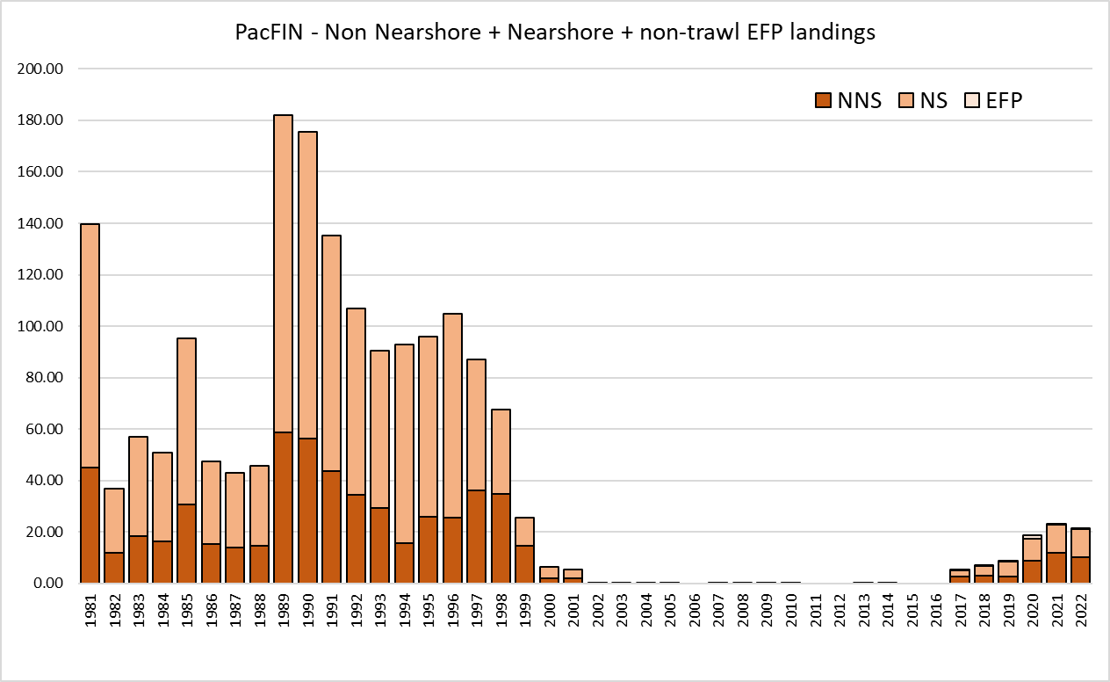
PacFIN - Non Trawl Landings (mt),EFP vs Directed Fishery

Slide 21
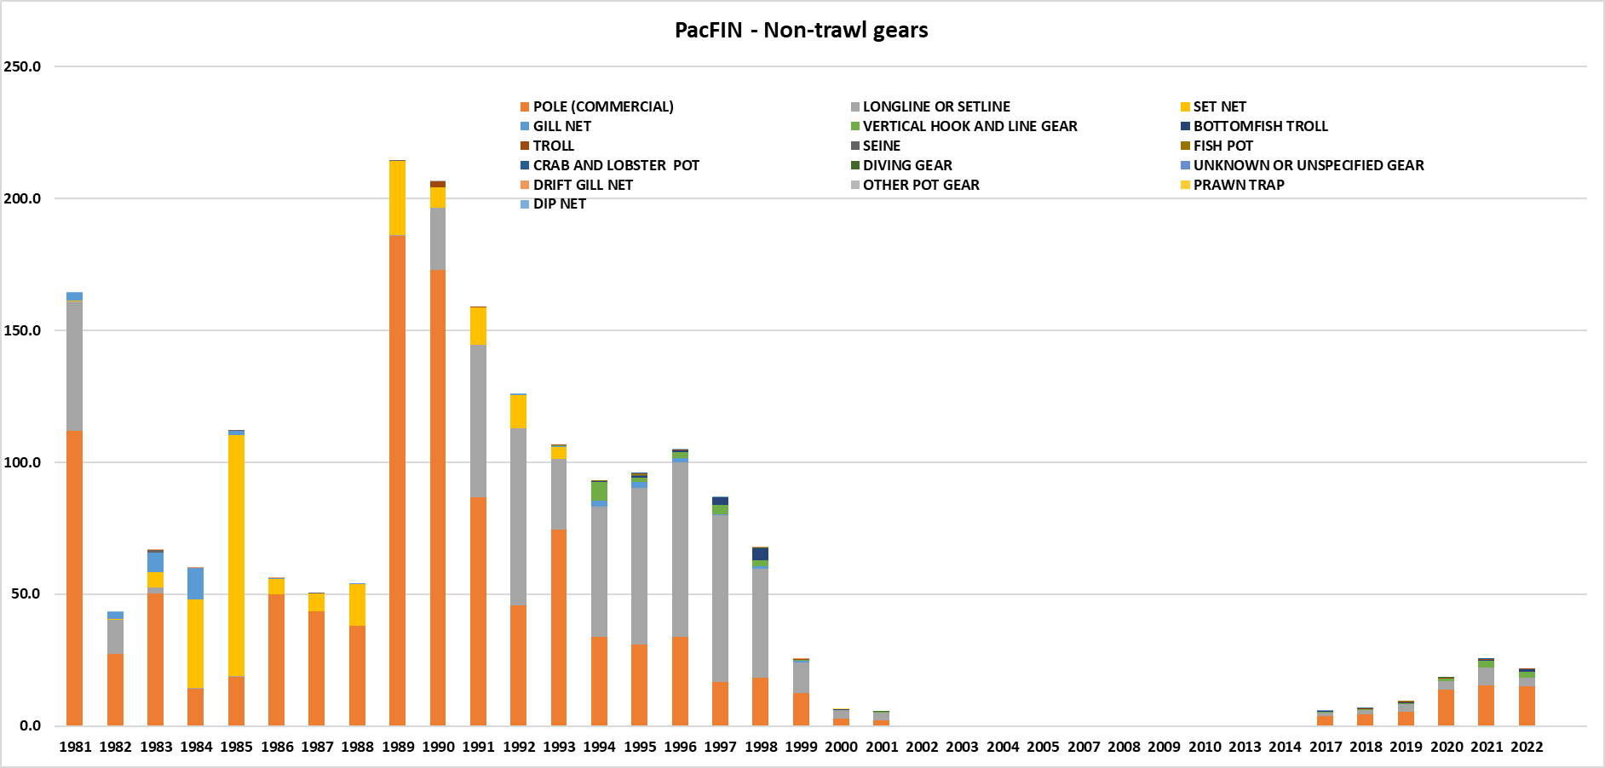

Slide 22
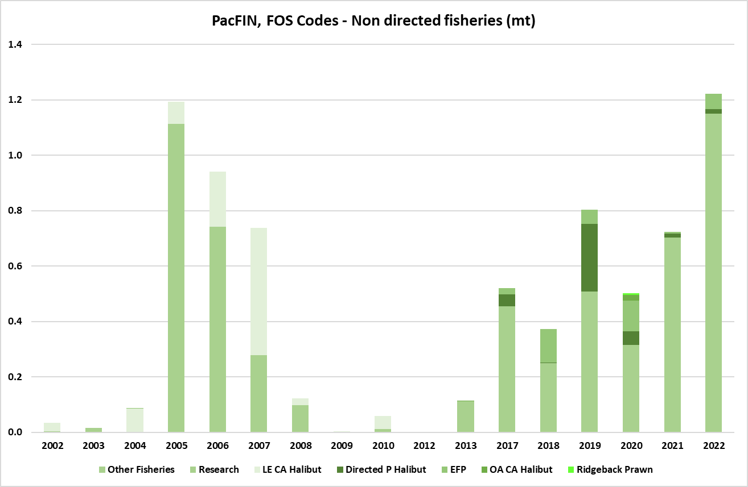

Slide 23
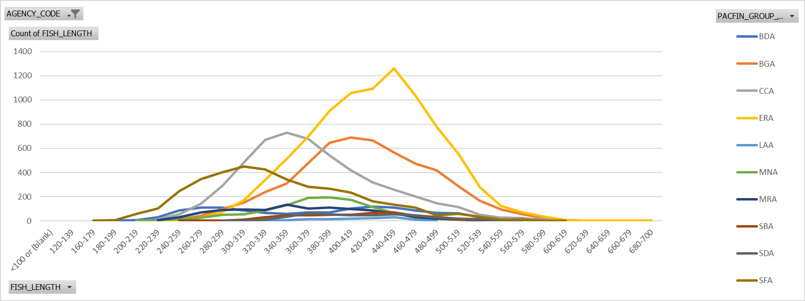
Length Composition by Port Group

Slide 24
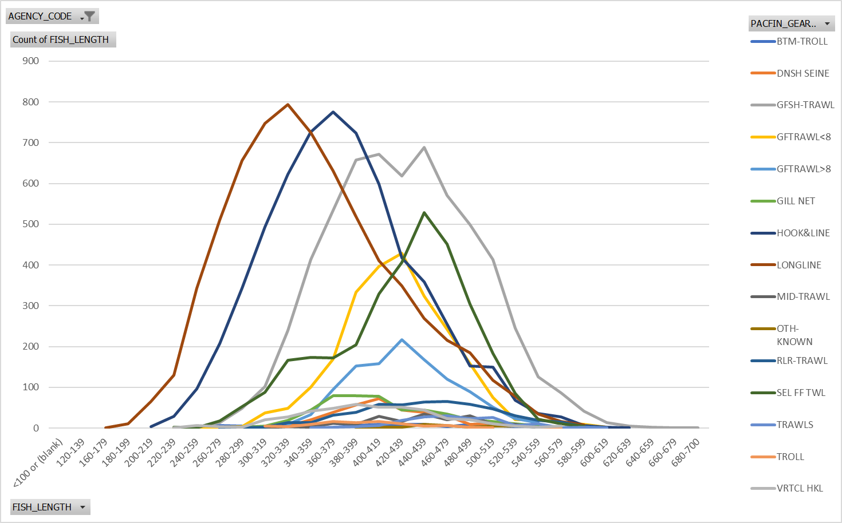
Gear Types - Trawl vs. Non-Trawl
Notes:
Cannot separate nearshore and non-nearshore without using block codes to assign trips or digging into WCGOP data with depth. Catches are large enough for both to consider parsing nearshore vs. non.

Slide 25
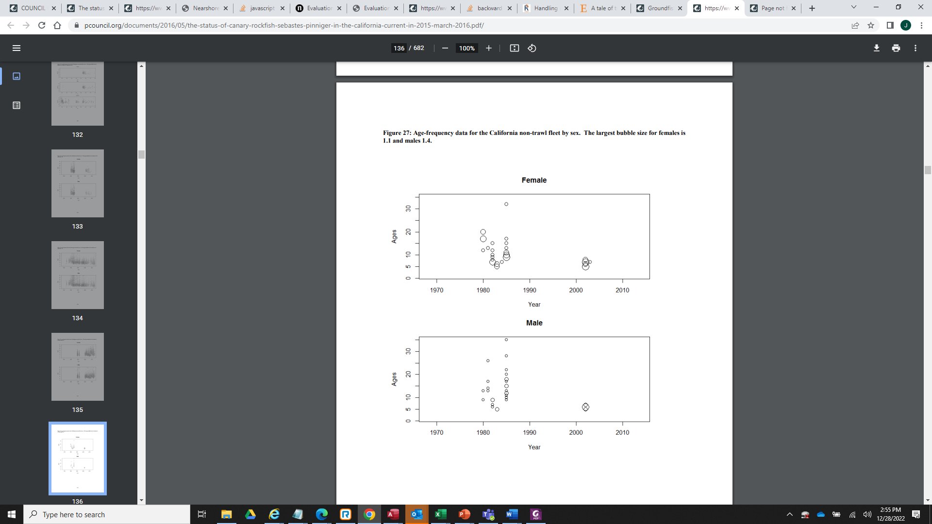
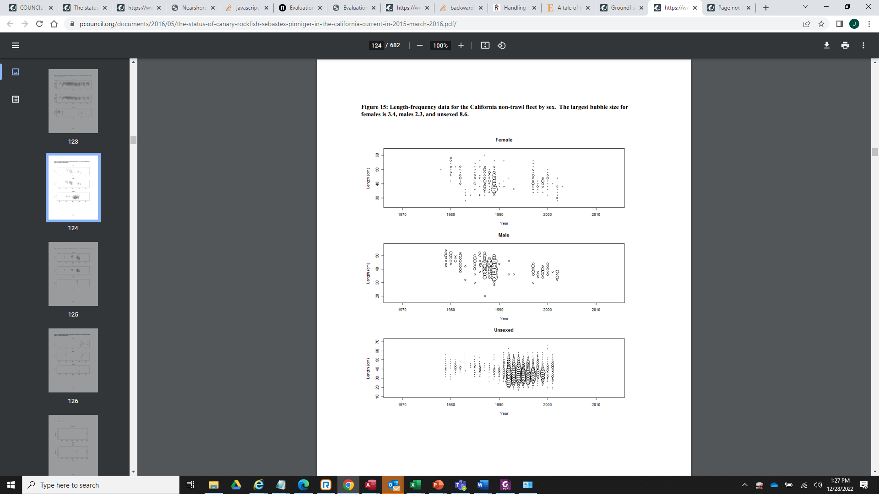
Non-Trawl Composition

Slide 26

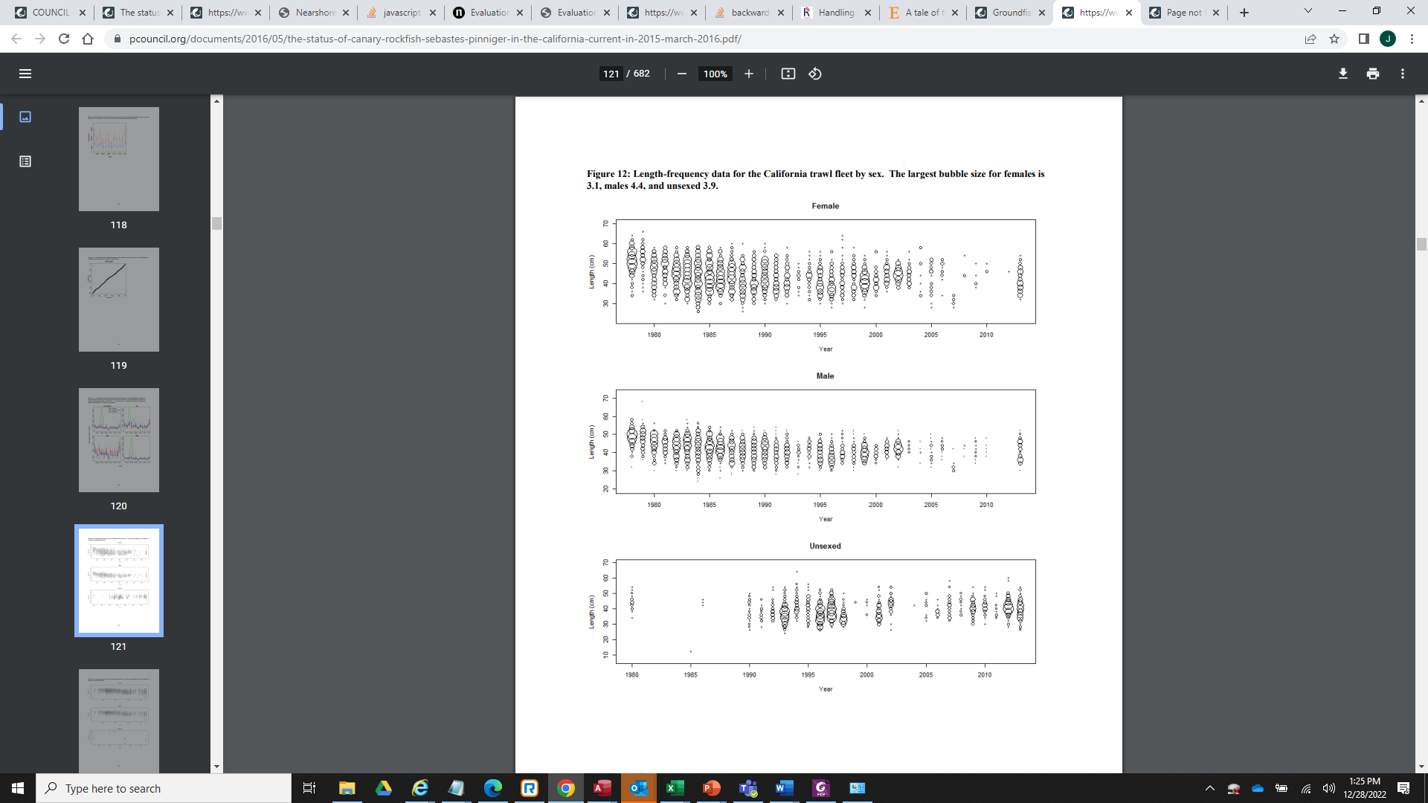
Trawl Composition

Slide 27
Commercial Topics for Further Analysis
Nearshore vs. non-nearshore non-trawl onshore vs offshore
Use block codes to assign trips to each and compare composition data.
WCGOP depth data can also be used to parse limited data.
Extension of bubble plots of length composition to look at patterns recent term across sectors or gear types.
Comparison of composition from roller gear vs. small foot rope to examine effects of more limited access to rocky reef on composition.
Could provide some basis for whether the trawl survey lacks access to larger and potentially older females.

Slide 28
End

Slide 29
Availability/Selectivity Distributions
Both commercial and recreational access to adult biomass was highly restricted since 2001 and depth restrictions at 20 or 30 fm north of Pigeon Point Santa Cruz in the primary distribution in California.
North vs. South of Point Arena: Season differences and length distributions may require weighting of comps by catch in numbers and differential selectivity to represent the stock rather than just the fishery. No strong differences potentially in part the result of high movement of adults compared to copper and quillback rockfish.

Slide 30
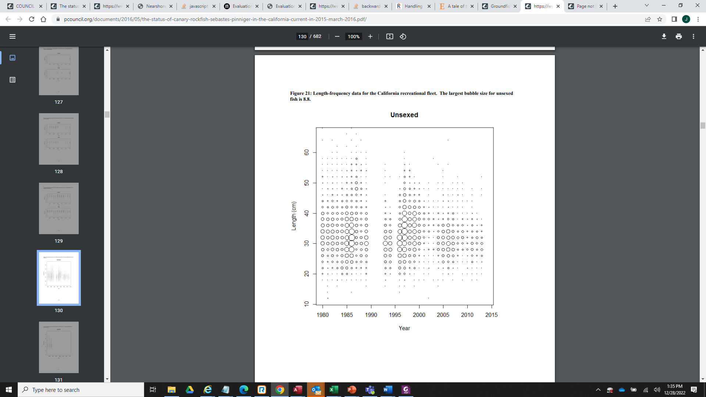
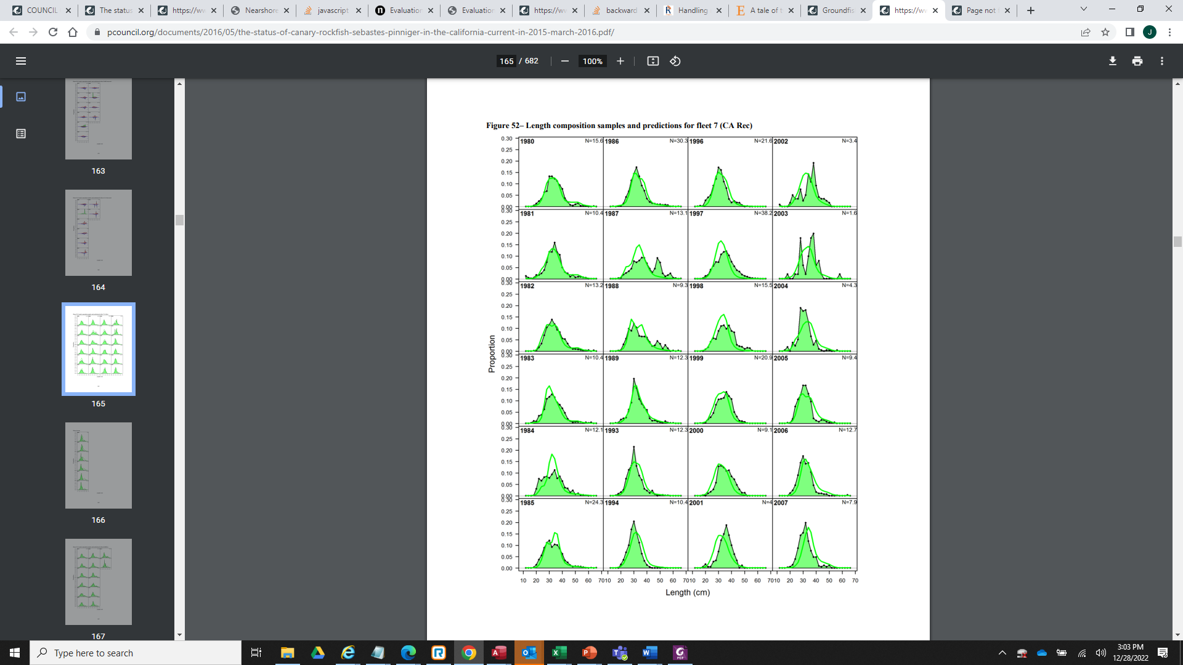
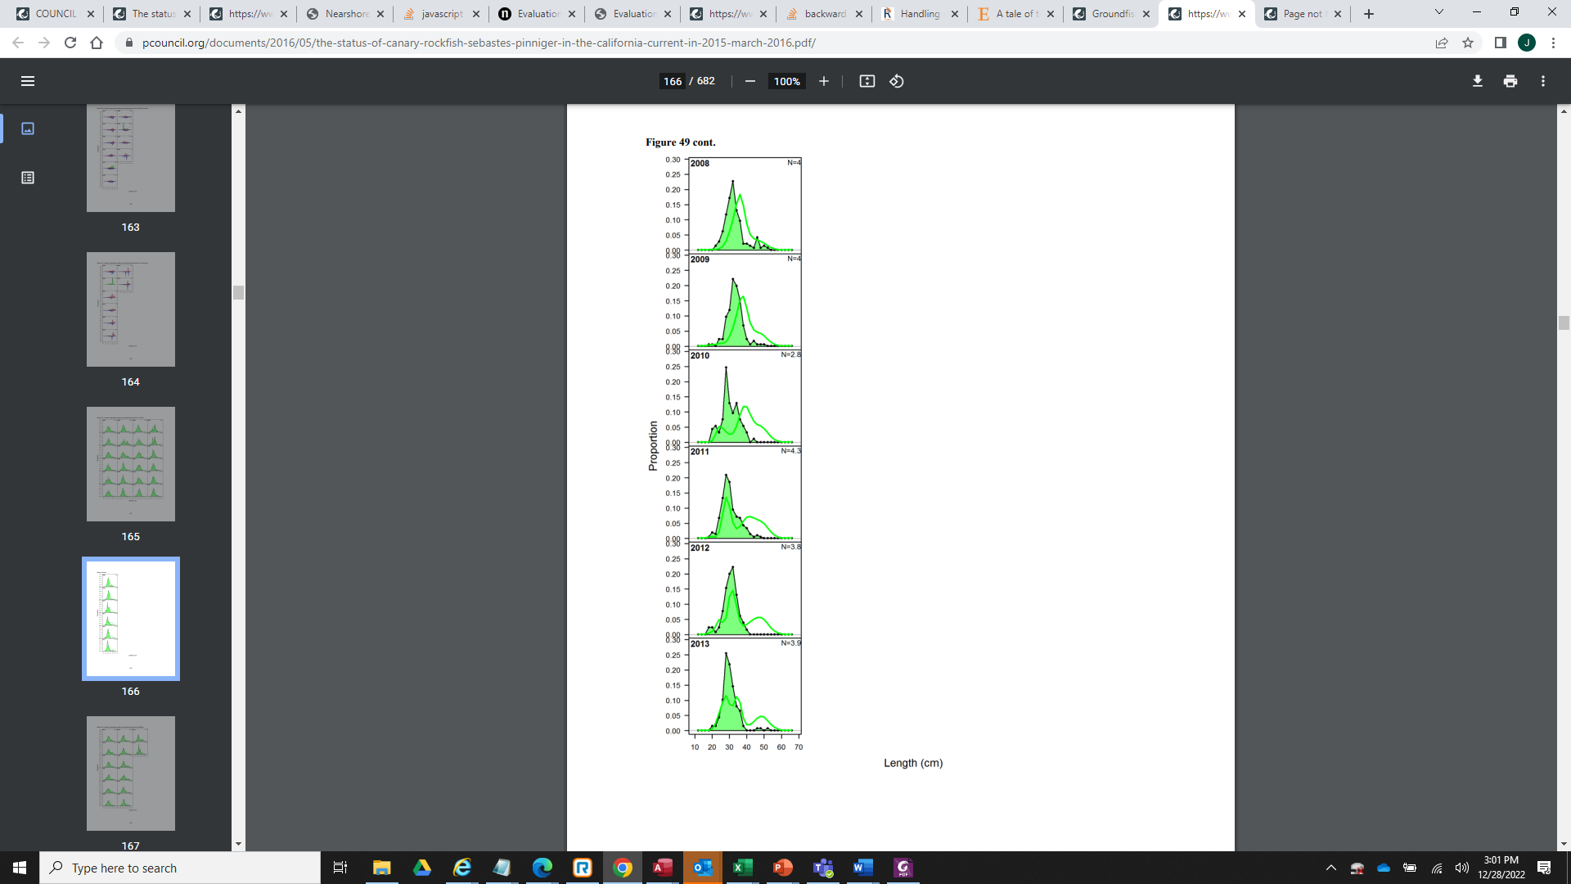
Recreational Length Composition

Slide 31
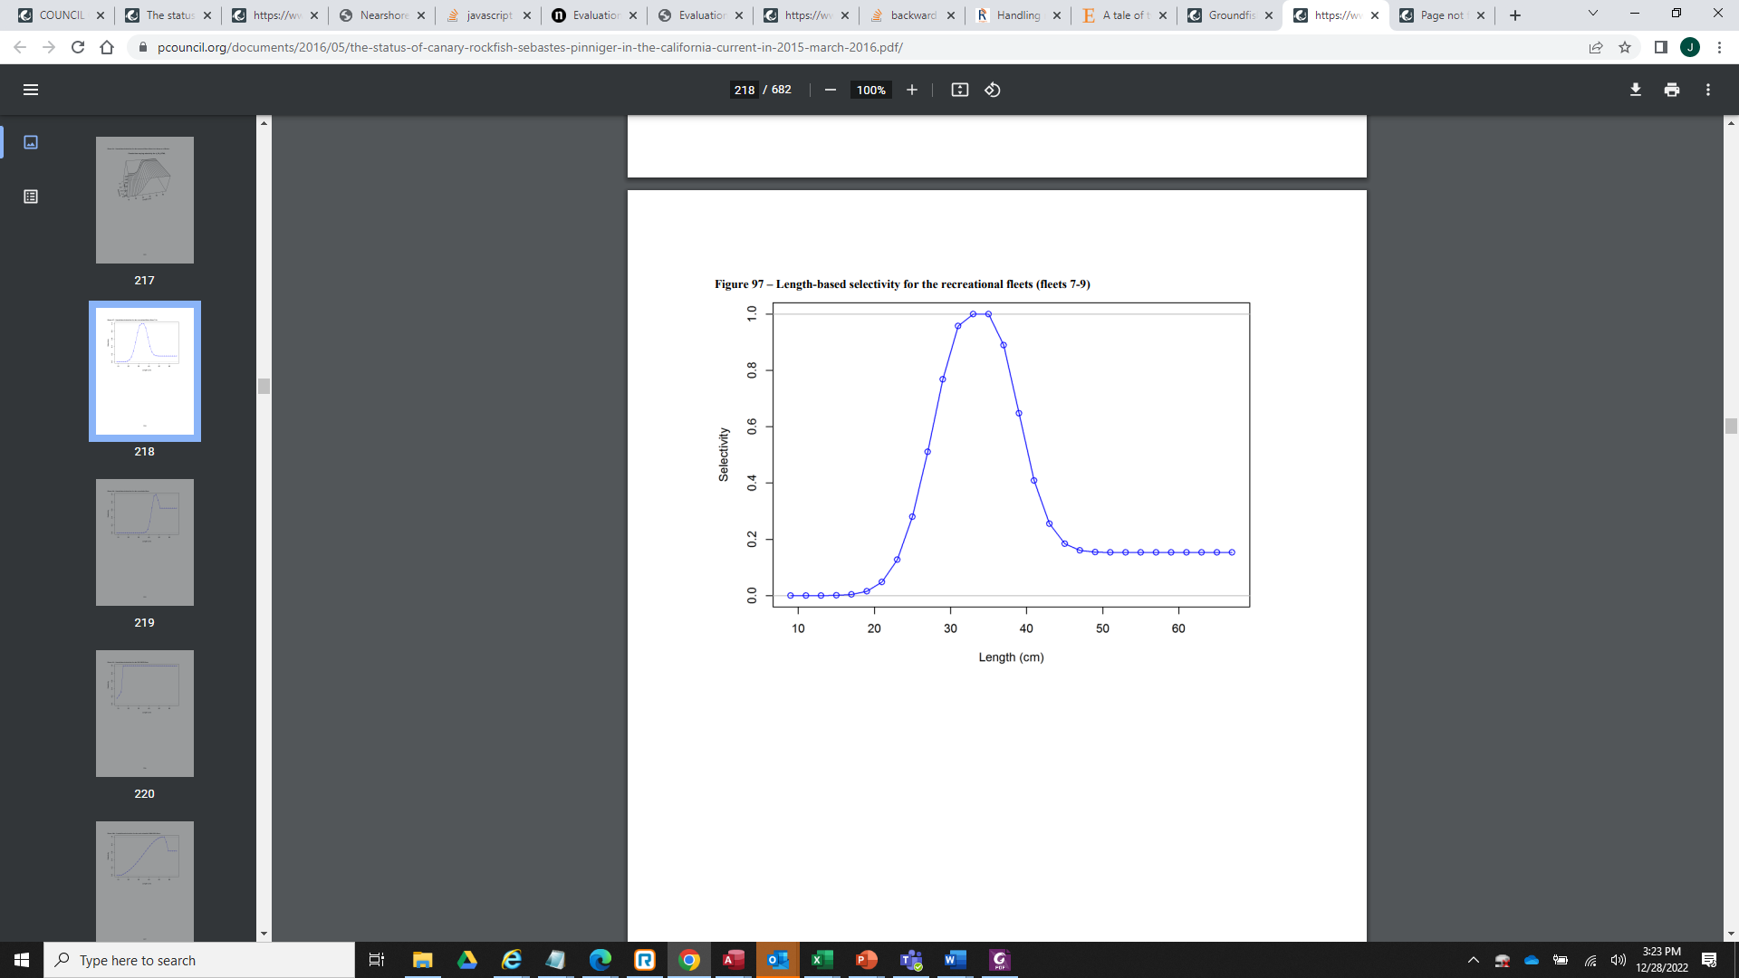
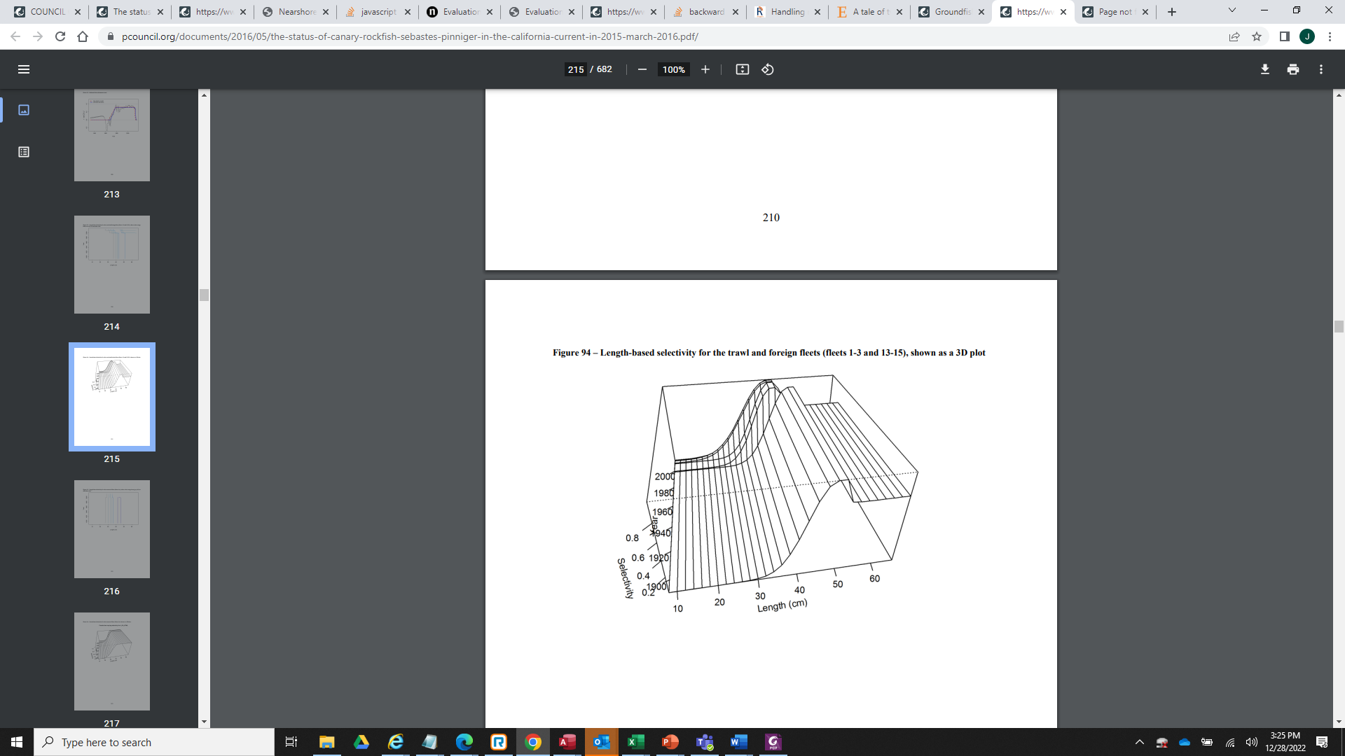
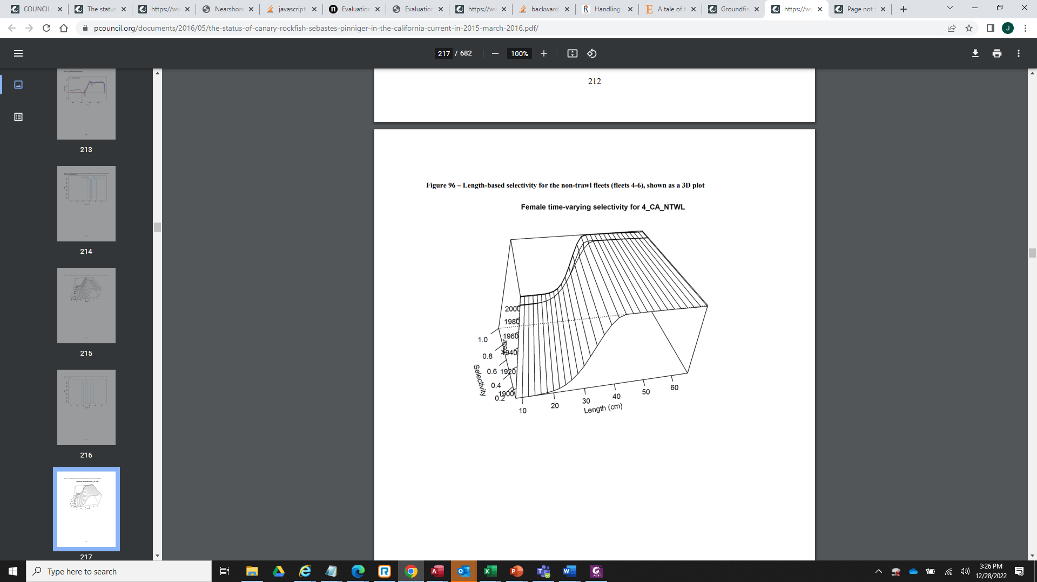
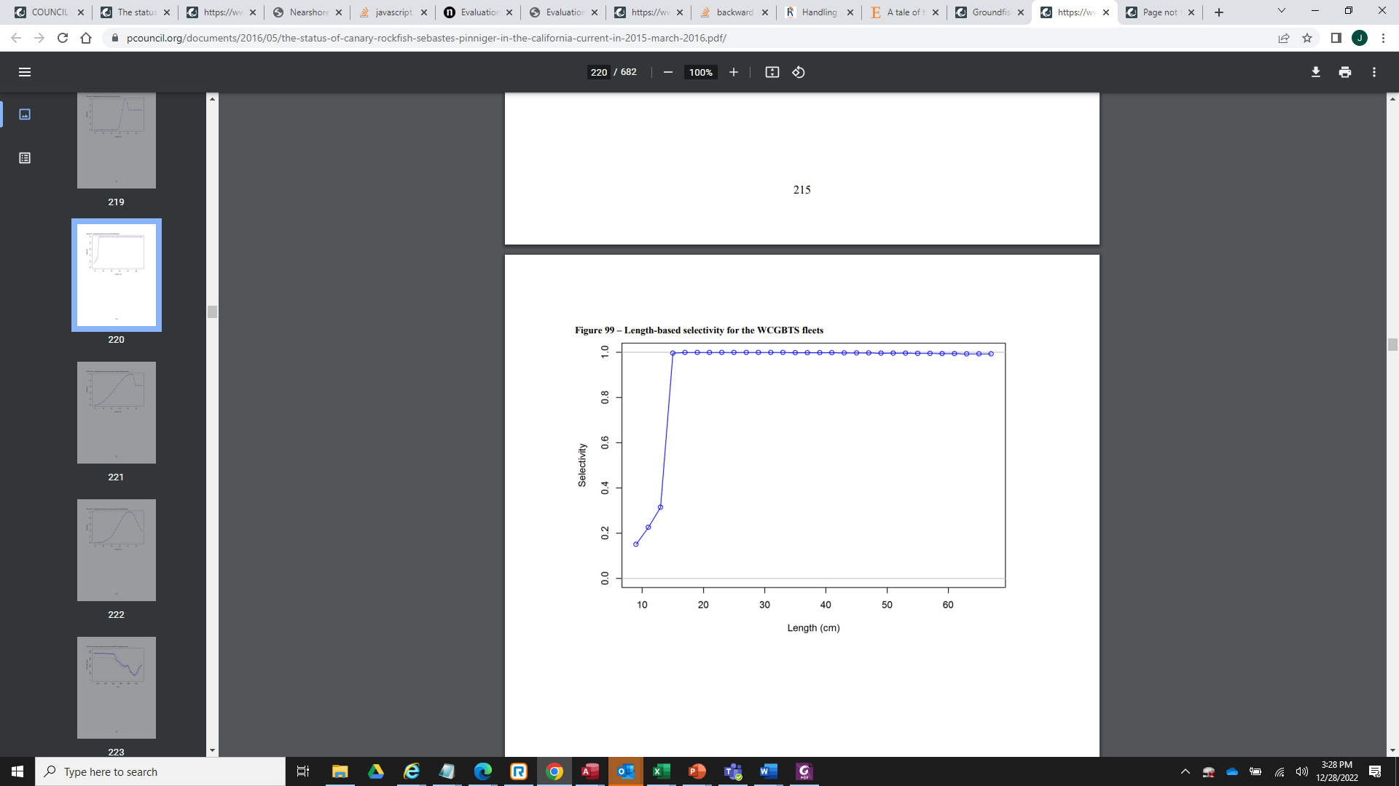
Selectivity

Slide 32
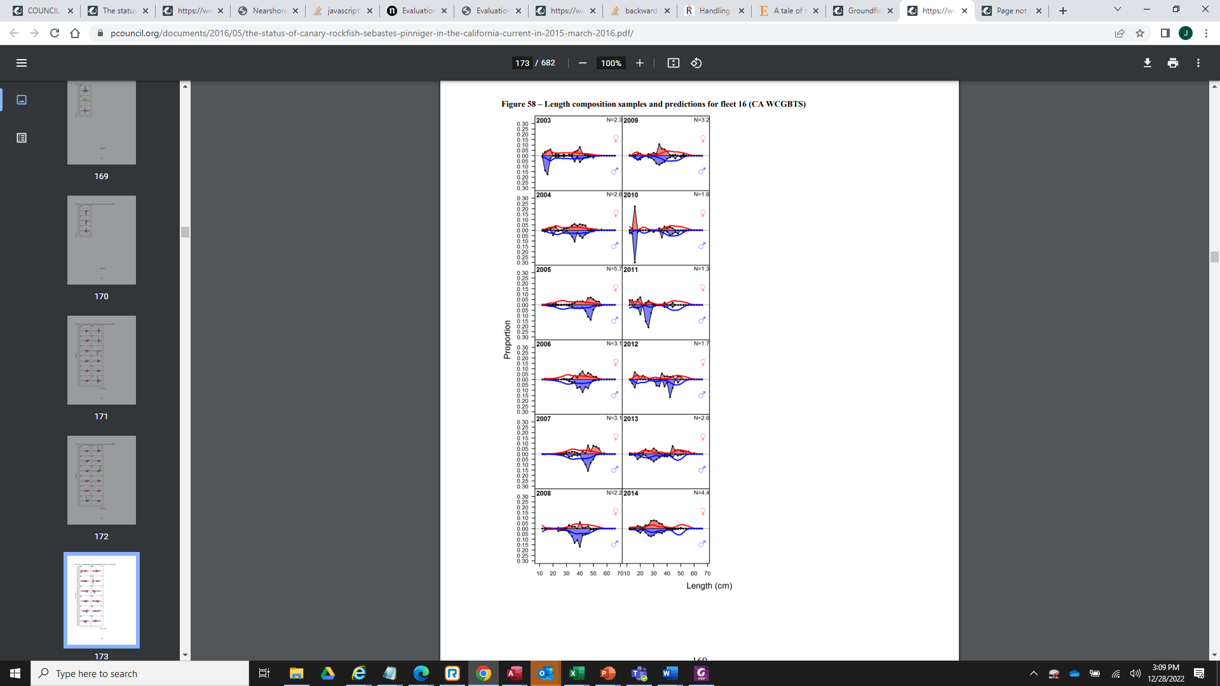
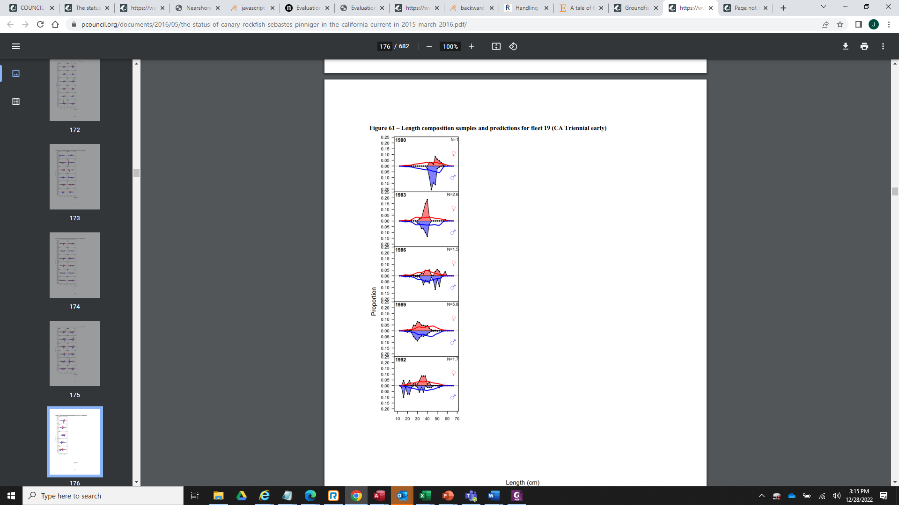
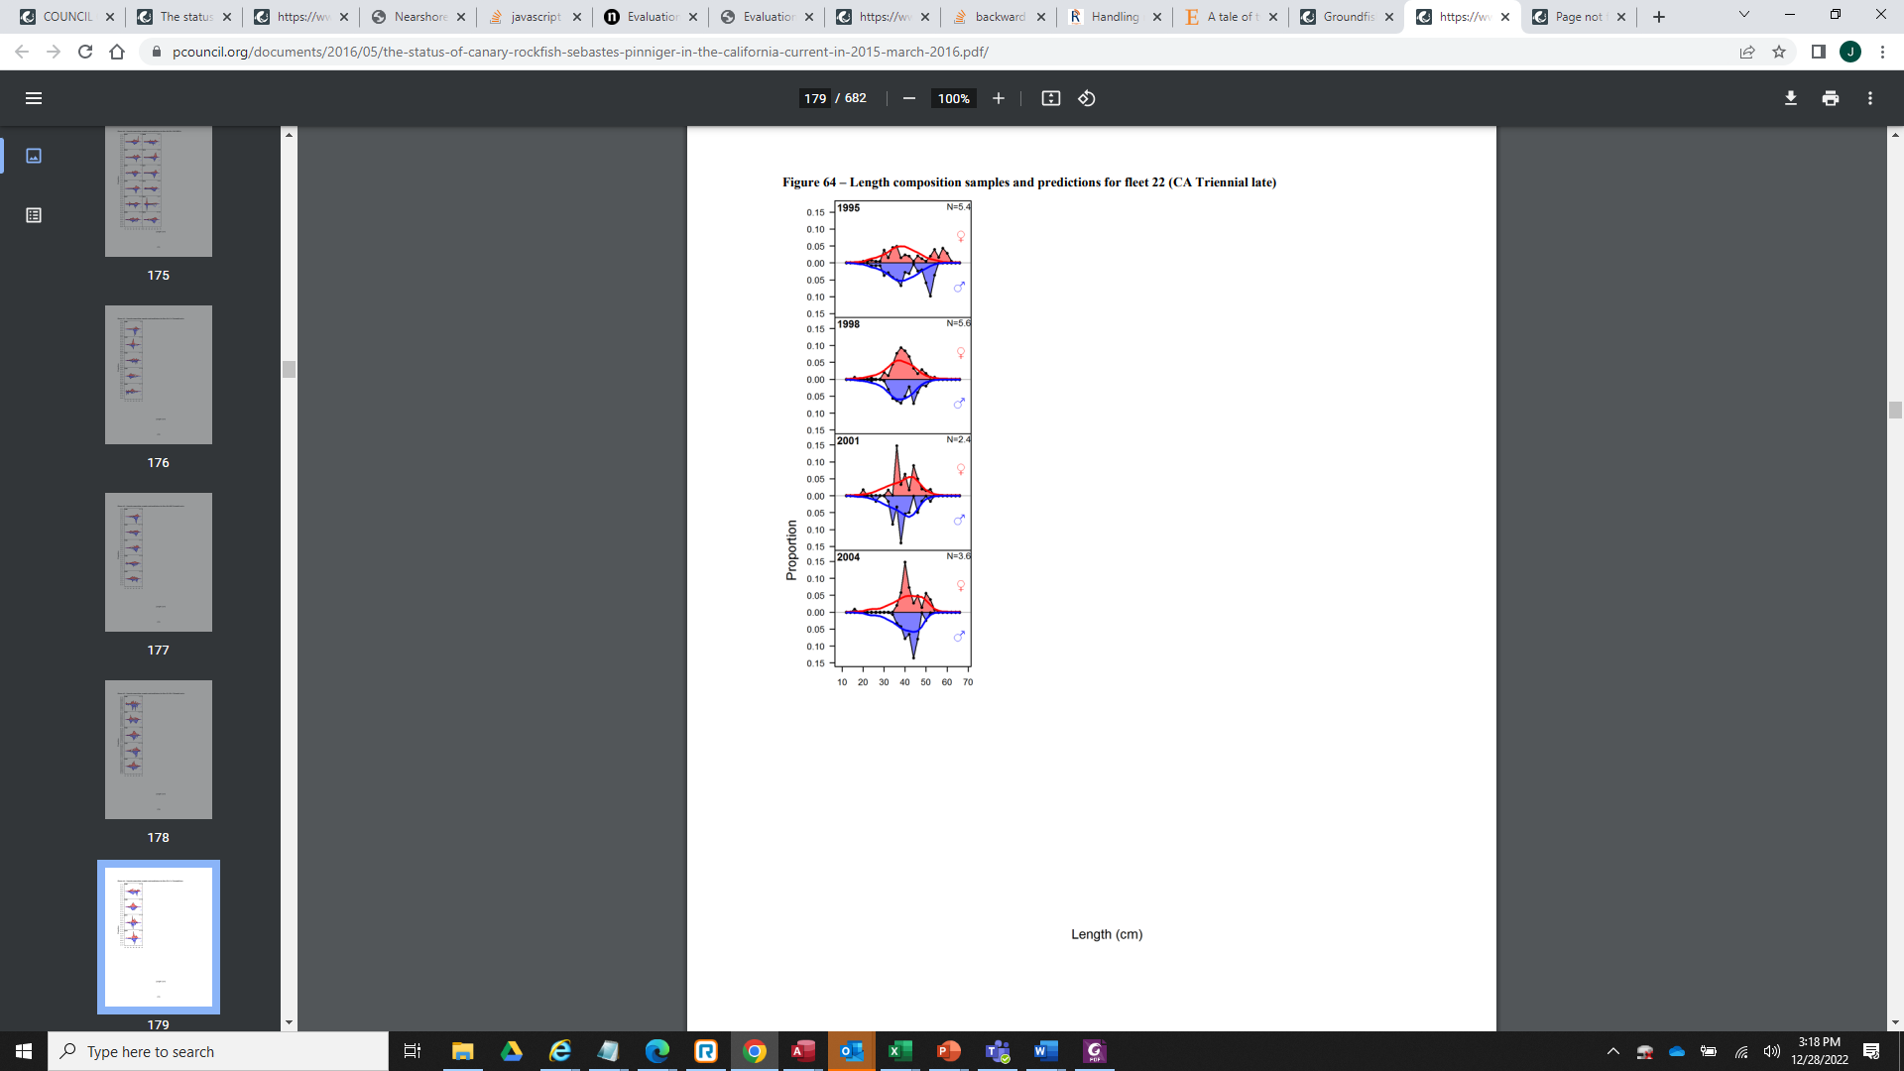
Where are the big females?
Model predicts larger fish in the recreational fishery.
Depth restrictions prevent access.
Trawl Survey Data still seeing them?
ROV data patterns in length with depth in the ~6000 observations in 2014 and 2020
In the updated data reflecting resumed access do we see them again indicating they were unavailable due to depth restrictions.
Examine composition in months deeper depths were accessible.
Expectation of model based on observations in OR/WA?
Potential growth differences along the coast?
Southern end of range- potential recruitment and nursery, but not adult primary range. Seen in other Sebastes.

